Slide 1
Schlumberger Algeria Overview Zied Ben Hamad North Africa General Manager Houston January 29th 2018

Slide 2
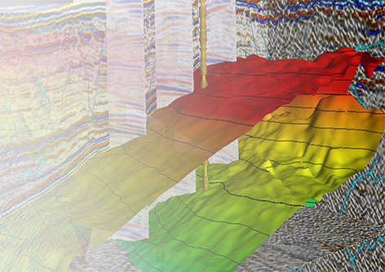
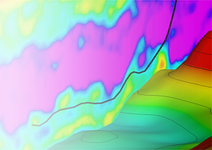
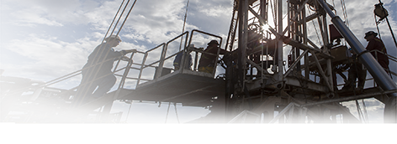
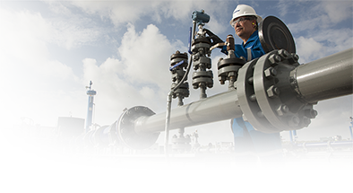
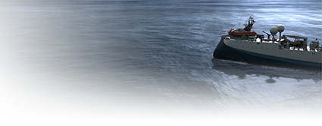
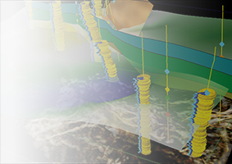
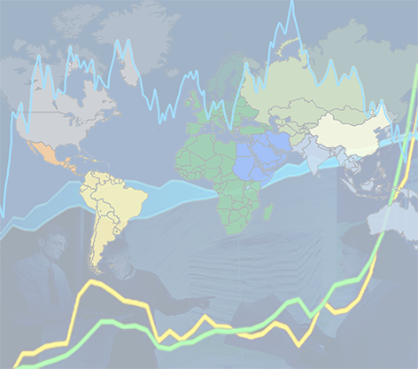
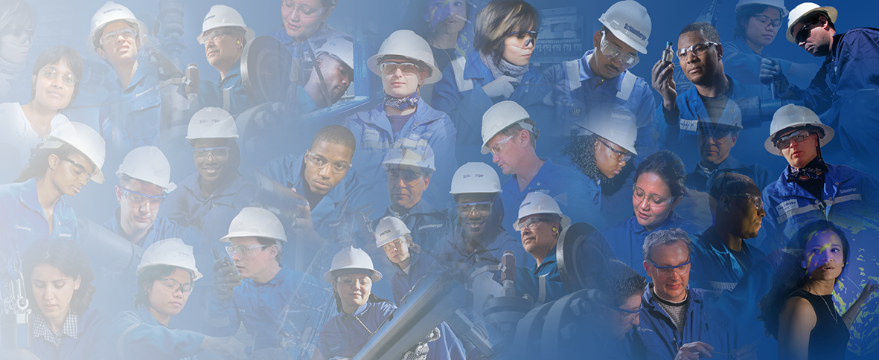
Schlumberger at a Glance
Characterization
Drilling
Production
Wireline
Testing Services
OneSurface
WesternGeco
Software Integrated Solutions
Integrated Services Management
Drilling & Measurements
Drilling Tools & Bits
M-I SWACO
Integrated Drilling Services
Land Rigs
Well Services
Completions
Artificial Lift
Lift Solutions
Integrated Production Services
Production Management
2017 Financials
Cameron
Revenue: $30.4 billion
Net Income: $ 2.1 billion
R&E: $ 1.1 billion
Approximately 120,000 People
OneSubsea
Drilling Systems
Surface Systems
Valves & Measurement
Representing 140 Nationalities
16 GeoMarkets i
Research, Engineering & Manufacturing Centers located in 18 countries
Working in more than 85 Countries
Notes:
CC: remove process systems from Cameron. No new segment to RCG. However, I can see a possible renaming of Testing Services coming, new president and all…… Recall TPS, Testing & Production Services? I think I still have a Tee shirt somewhere…..

Slide 3
Technology Investment
Revenue
R&E Budget

Slide 4
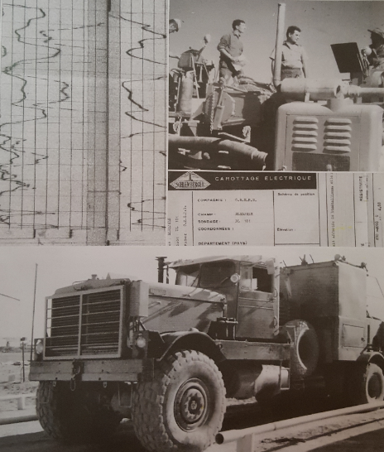
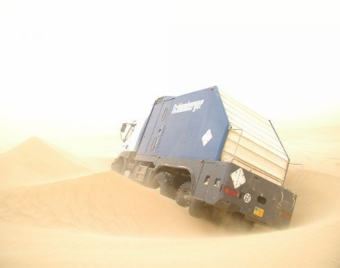
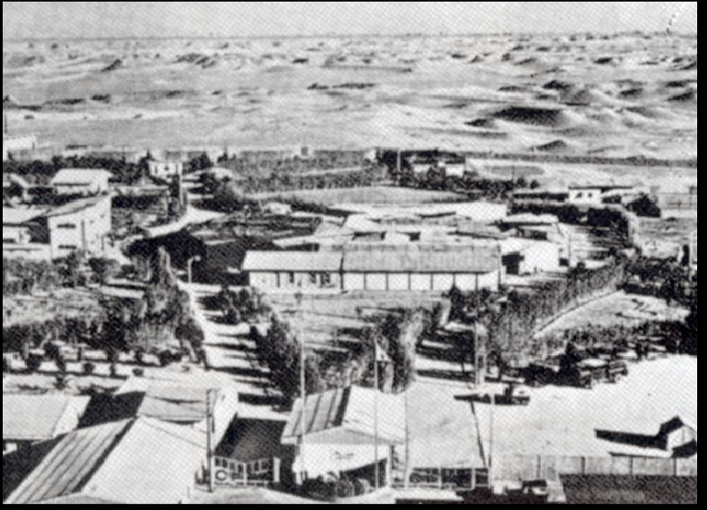
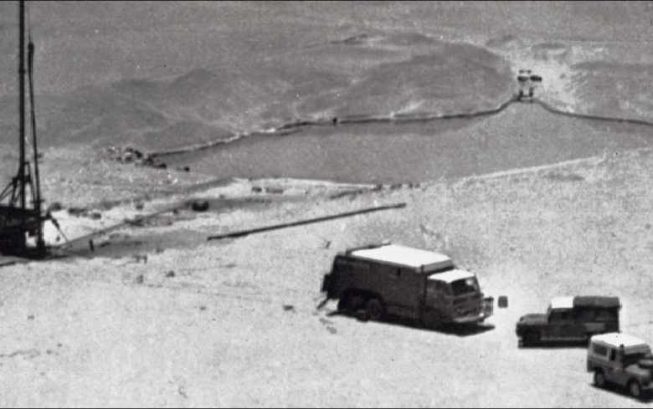
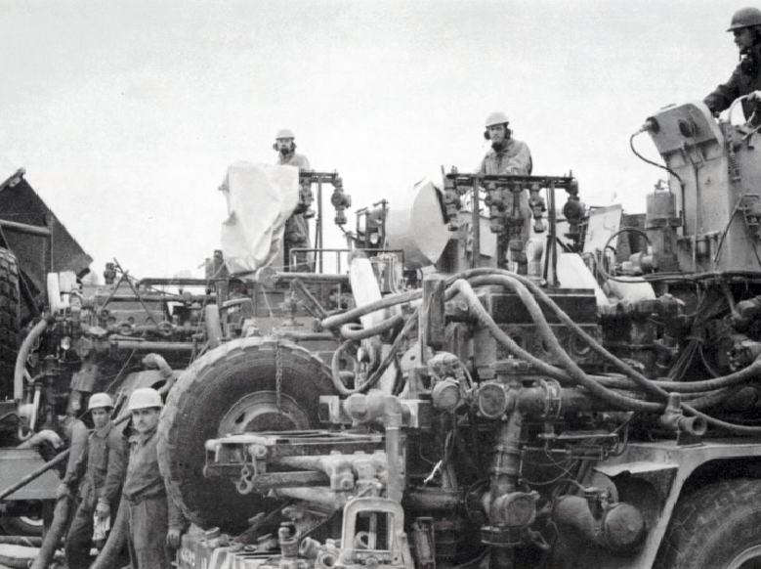
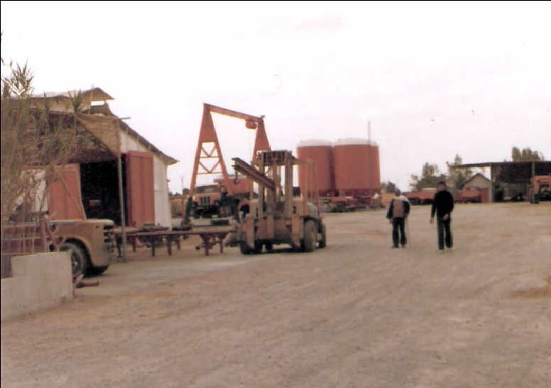
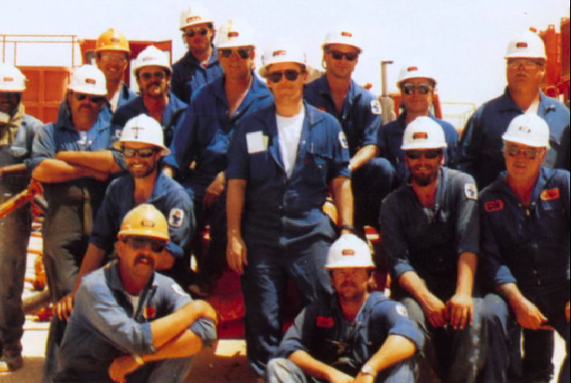
History
Continuous presence in Algeria for over half a century
First wireline logging services in 1955
Facilities in all major O&G provinces
Algerian workforce of over 2,500. One of the largest in the world

Slide 5
Schlumberger Locations in Algeria
Head Offices:
Algiers (ALG)
Operations Bases (x11):
8 x Hassi-Messaoud
In Amenas
Hassi-Berkine
In-Salah
Bunkers (x4):
Hassi-Messaoud
In Amenas
Berkine
Adrar
ALG
HMD
HBK
INA
AZR
ISA

Slide 6
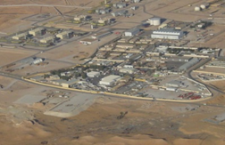
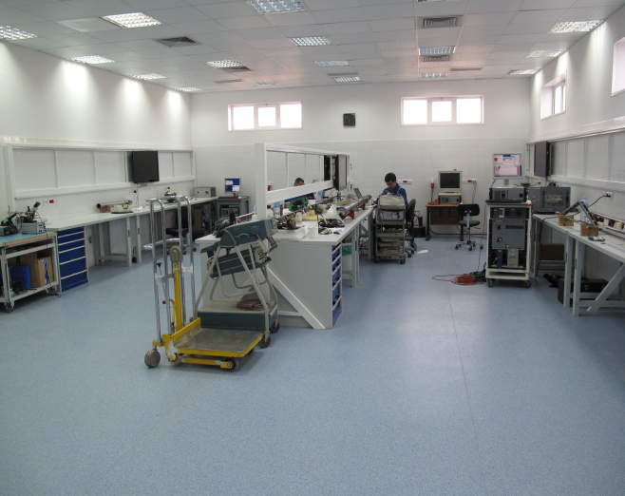
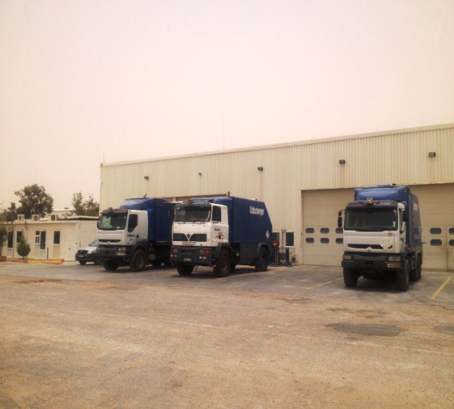
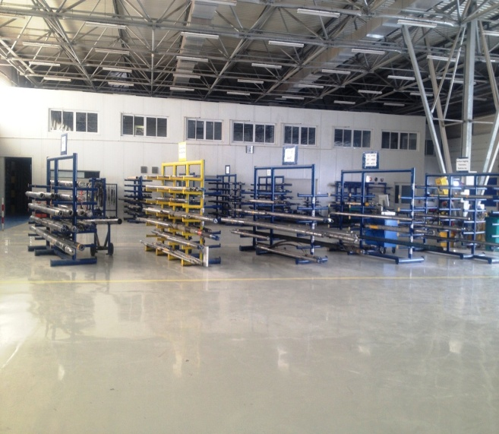
Hassi-Messaoud Base (MD-1)
Main base Logging, Testing and Drilling
Maintenance facilities
Equipment storage
Testing and calibration
Living quarters

Slide 7
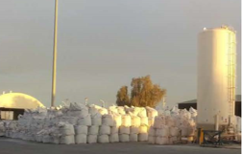
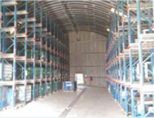
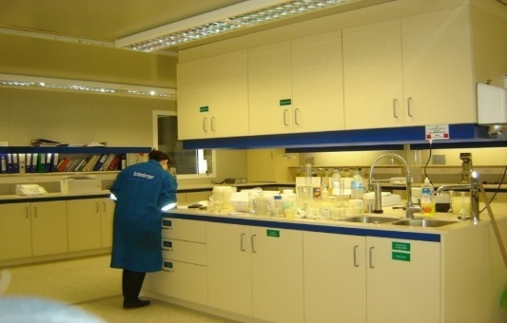
Hassi-Messaoud Base (MD-2 , MD-3 & MD4)
Main base for Pumping
Mechanical Workshops
Electronics Lab Support
Accommodation
Bulk Plant and Chemical storage
Cementing & Stimulation Laboratory
Cement Blending
Acid and Brine mixing

Slide 8
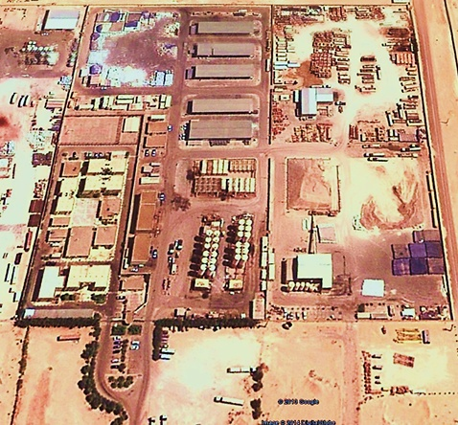
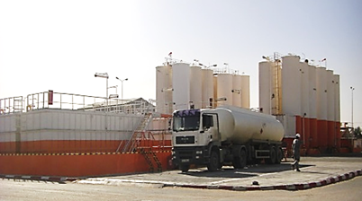
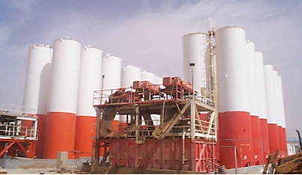
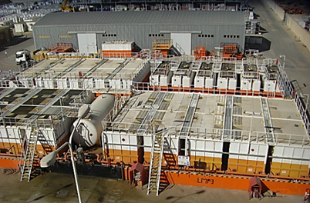
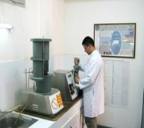
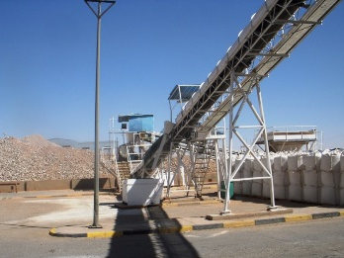
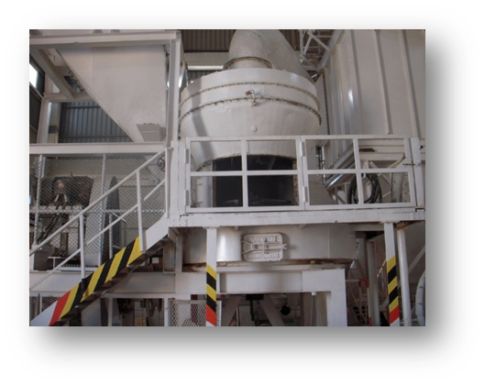
M-I SWACO Base
HMD base, 80 000m² area
Offices, Living quarters, Product yard, LMP, Barite Mill.
HMD LMP Total Volume Capacity 7,579 m3 /
Total Diesel Storage tanks for rig site operation: 2,765 m3
Barite Mill : 150 Ton/day

Slide 9
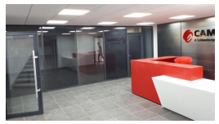
CAMERON Base
CAMERON presence in Algeria since 1960’s
New Facility in Hassi-Messaoud, ready Q -21108
All operations consolidated into 1 single new location: repair, maintenance, inspection, testing & tooling
Rig BOP maintenance will be performed in Algeria

Slide 10
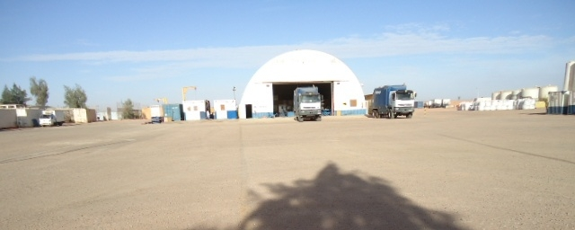
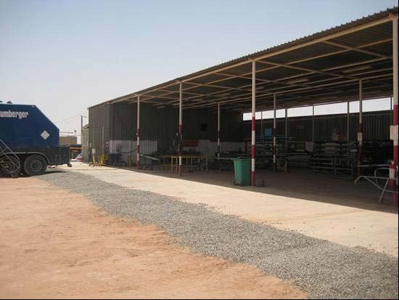
In-Amenas Base
In-Salah Base
Accommodation for 100 people
Mechanical & Electrical Labs
Bulk Plant cement & chemicals
Tool workshop
Calibration Area
Covers South & West Algeria, Tidikelt, Reggane, Adrar, Bechar
Mechanical & Electrical Labs
Bulk Plant for cement & chemicals
Tool workshop
Calibration Area

Slide 11
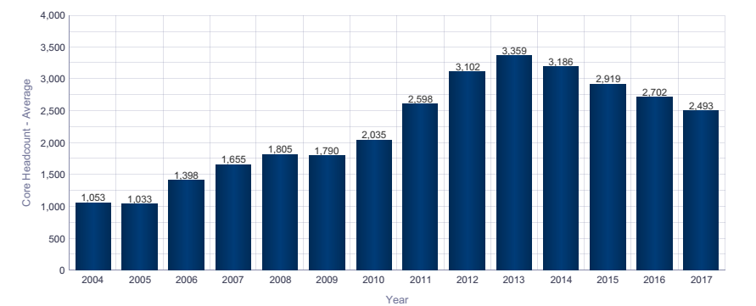
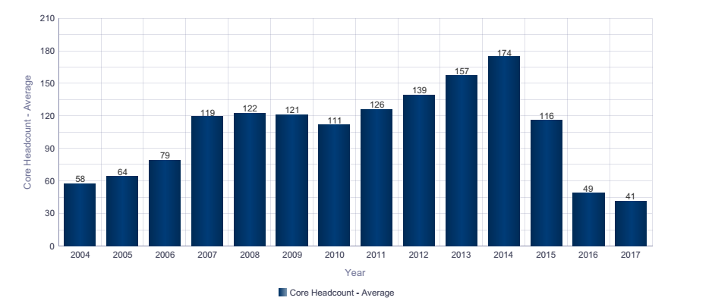
Algeria Headcount Evolution & Algerian International Headcount

Slide 12
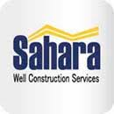
Main investments & projects
Sahara
Schlumberger – ENAFOR JV
An Algerian Well Construction Company
Created in 2010
5 rigs
MI Algeria
An Algerian Drilling Fluid Company
Schlumberger - Sonatrach (SPP) JV
Created in 1997

Slide 13
Schlumberger in Summary
The world's leading provider of technology for oil & gas reservoir characterization, drilling, production, and processing
Supplies the most comprehensive range of products and services and integrated pore-to-pipeline solutions that optimize hydrocarbon recovery to deliver reservoir performance
Unique global reach and culture, differentiated by geographically-focused operations, and world-class research, engineering and manufacturing networks
Backed by financial strength and a commitment to technical expertise and technology development
Notes:
CC: A couple bullet tweaks, copied and edited to suggested version below.
Second bullet V2: The most comprehensive range of services and products enabling pore-to-pipeline solutions that optimize production and recovery //// note many customers are more interested in production than recovery…. And ‘reservoir performance ‘ is redundant with production and recovery.

